Slide 1


FOOD PACKAGING TECHNOLOGY
Subject Code: FDPT 313 | B.Tech Food Technology
Comprehensive Study on Materials, Permeability, and Advanced Systems

Slide 2






Core Functions of Packaging
Protection
Containment
Communication
Shields food from physical damage, chemical contamination, and biological spoilage during transit.
Encloses products to facilitate efficient transport, storage, and handling in various sizes.
Provides legal information, nutrition facts, branding, and usage instructions to consumers.

Slide 3


Paper and Paperboard
Versatility: Lightweight and highly printable for branding.
Eco-Friendly: Biodegradable and easily recyclable.
Types: Includes Kraft paper, greaseproof paper, and corrugated fiberboard.
Limitation: Poor moisture and gas barrier properties unless laminated or coated with plastics/wax.

Slide 4

Glass: The Inert Barrier
Premium Protection
Glass is highly inert, making it the safest contact material for acidic and high-moisture foods.
Impermeability: Excellent barrier against gases and water vapor.
Transparency: Allows consumers to inspect product quality visually.
Challenges: Heavy weight increases shipping costs; fragility leads to breakage risks.

Slide 5
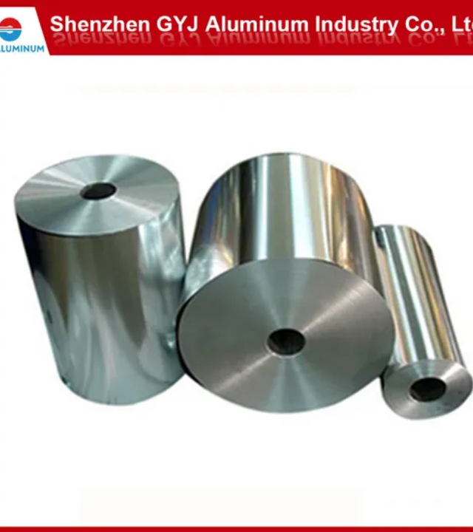
Metal Packaging Systems
Tinplate & Aluminum
Metallic containers offer total protection against light, air, and microorganisms, making them ideal for long-shelf-life canned goods.
Tinplate: Steel coated with tin for corrosion resistance.
Aluminum: Lightweight, flexible, and ideal for beverage cans and foils.
Mechanical Strength: High resistance to heat processing (Canning/Retort).

Slide 6


Plastic Materials & Properties
PET
HDPE
Polyethylene Terephthalate: High clarity, used for beverage bottles.
High-Density Polyethylene: Rigid and opaque, used for milk jugs.
LDPE
PP
Low-Density Polyethylene: Flexible, used for bread bags and wraps.
Polypropylene: High heat resistance, suitable for microwavable tubs.

Slide 7
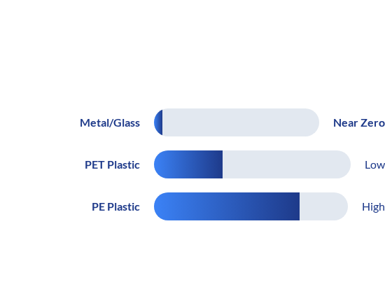

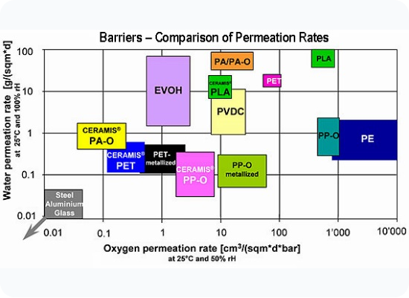
Technical Concept: Permeability
Permeability determines how easily gases and vapors pass through a packaging material. Lower permeability equals better shelf-life.
Measured as OTR (Oxygen Transmission Rate) and WVTR (Water Vapor Transmission Rate).

Slide 8







Active Packaging Systems
Oxygen Scavengers
Moisture Absorbers
Antimicrobials
Incorporates agents into the film to inhibit the growth of spoilage bacteria on surfaces.
Removes residual oxygen in the headspace to prevent oxidation and rancidity in fats.
Controls relative humidity to prevent sogginess in dry snacks or mold growth in fresh produce.

Slide 9
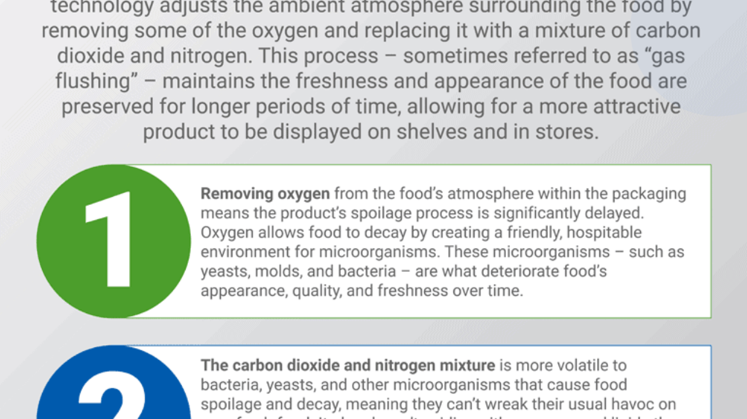



Modified Atmosphere Packaging (MAP)
Replacing air inside a package with a protective gas mixture to extend fresh product life.
CO2 (Carbon Dioxide)
N2 (Nitrogen)
Bacteriostatic effect; inhibits growth of aerobic bacteria and molds.
Inert filler gas used to prevent package collapse and exclude oxygen.

Slide 10


QUESTIONS?
Thank you for your attention
B.Tech Food Technology
Exam Preparation Study Resource - 2026

Slide 11






Image Sources
https://cdn.mos.cms.futurecdn.net/fb3D4DMdV2M8m9DhFdhZh5.jpg
Source: www.creativebloq.com
https://static.vecteezy.com/system/resources/previews/046/122/571/non_2x/fresh-and-colorful-assortment-of-fruits-and-vegetables-in-a-cardboard-box-organic-produce-collection-concept-of-healthy-eating-farm-produce-delivery-natural-food-isolated-on-white-background-photo.jpeg
Source: www.vecteezy.com
https://files.ekmcdn.com/s4ushop/images/glass-storage-jars-breakfast-set-546-p.jpg
Source: www.sourcing4u.co.uk
https://image.made-in-china.com/202f0j00RsPhfdjAkZqz/15mic-15um-15micron-Aluminium-Aluminum-Foil-8079-O-Um-Micron-Heat-Sealing-Foil-for-Food-Lidding-Foil-Yogurt-Lidding-Milk-Powder-Cans-Lidding.webp
Source: gyjaluminum.en.made-in-china.com
https://www.silganplastics.com/wp-content/uploads/2023/08/Stock-Food.png
Source: www.silganplastics.com
http://www.polyestertime.com/wp-content/uploads/2016/06/O2-Permeation-27-06-2016.jpg
Source: www.polyestertime.com

Slide 12



Image Sources
https://www.cilicant.com/wp-content/uploads/2019/09/Process-Food-inner-hero.png
Source: www.cilicant.com
https://img.magnific.com/free-vector/thank-you-your-attention-sign-illustration_23-2150308623.jpg?semt=ais_hybrid&w=740&q=80
Source: www.magnific.com
https://www.p5pkg.com/wp-content/uploads/info-1.webp
Source: www.p5pkg.com

